Slide 1
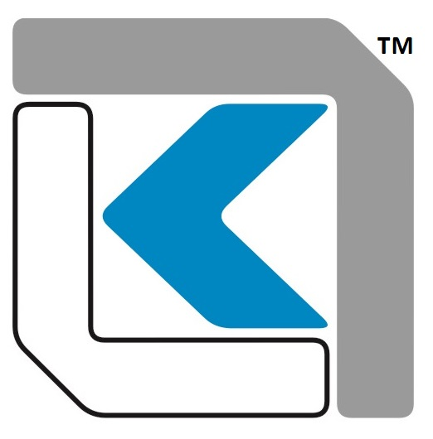
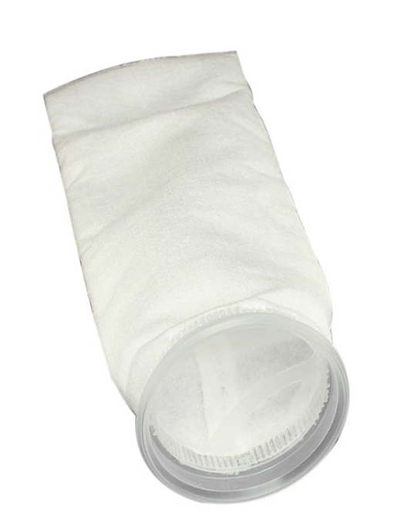
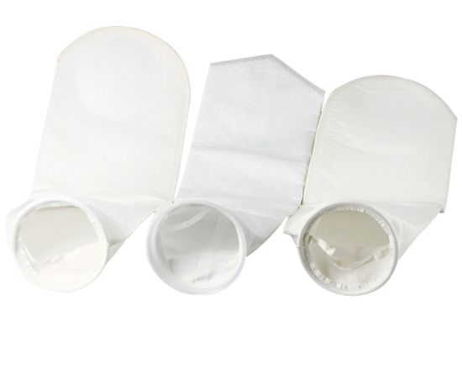
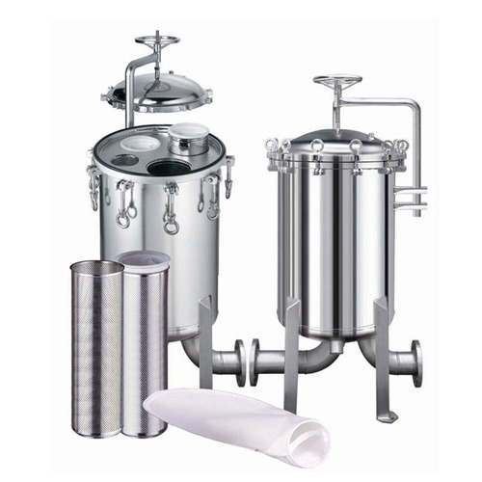
KGT BAG FILTER
ABOUT
The KGT Bag filter element has a fixed pore structure making them absolute rated which enables removal of contamination at consistent efficiency.
Apart from the wide chemical compatibility, the filters are suitable for either high flow rate or high viscous liquid, having a high dirt holding capacity as they are available in polypropylene and polyester media.
The KGT Bag filter element is available in various media enabling it to handle a wide range of fluids.
ADVANTAGES
Due to wide range of media selection, the KGT Bag filter can be used for various liquids – acids, alkalis, sea water, process water, lube oils to light petroleum fluids.
Standard dimensions of 4” and 7” outer diameter ensures fitment in most standard housings with varied length availability. (other dimensions available on request)
Available in 16 and 32 inches in length. (Other lengths available on request.)
Sealing collars available in polypropylene and Steel rings.
DIFFERENCIAL PRESSURE DATA
For Normal Flow from Inside to Outside for liquids compatible with the filter media, the maximum differential pressure is
Polypropylene Medium: 15psid (1.0 bard)@75⁰C
Polyester Medium: 15psid (1.0 bard)@135⁰C
(This DP data is compiled for water service)
APPLICATIONS
Process Water Lube Oils
Amine, Glycol Brine, Seawater

Slide 2
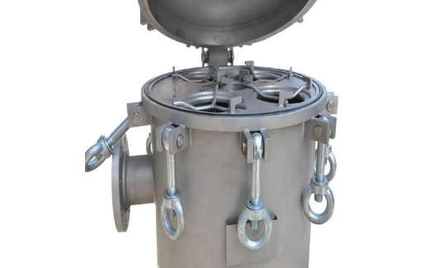
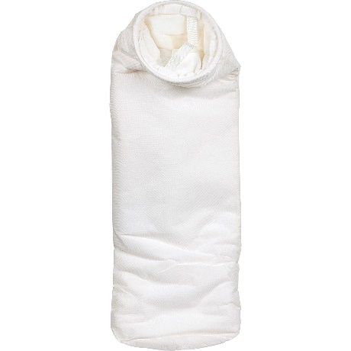
KGT BAG FILTER
PART NUMBERING GUIDE
Filter Element Part Number : KGT
 | Collar |  |  | Filter Media
Short Code | Description |  | Short Code | Description
P | Polypropylene |  | P | Polypropylene
PS | Polyster |  | PS | Polyster
S | Steel Ring
 | Diameter (Inches) |  |  | Length (Inches)
Short Code | Description |  | Short Code | Description
4 | 4 |  | 17 | 17
7 | 7 |  | 32 | 32
 6, Anurag, Rajaji Path, Ramnagar, Dombivli, Mumbai, 421201, Maharashtra, India
 +91 251 2420878  +91 9166 593 315  solutions@klengas.com

